Slide 1
Identification of cattle ( Cow & Buffalo ) Tow type of identification of cattle these are 1-collective identification Which depending on the Trade mark, which made or present on the Neck or the quarter--------etc . 2-Individual identification. Which depending on :- a-Name of animal -----like--------- Zanoba

Slide 2
b-Number
The numbering can doing by different method like:-
1-Branding –firing .
2-Tattooing .
3-Tagging :- by use special machine which fixed the number on the ear.

Slide 3
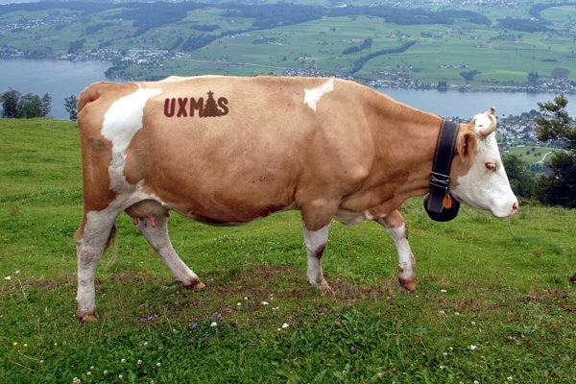
Branding -firing

Slide 4
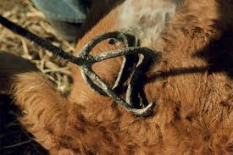
Branding -firing

Slide 5
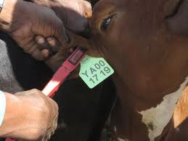
Tagging

Slide 6
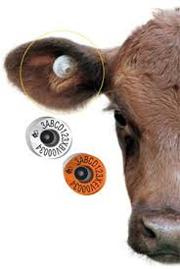
Tagging

Slide 7
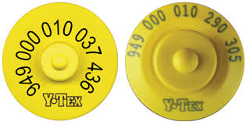
Type of marks

Slide 8
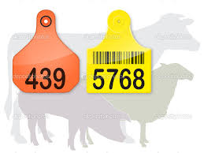
Type of marks

Slide 9
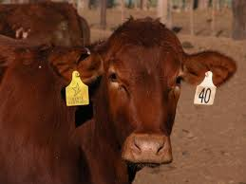
Tagging

Slide 10
c-Species-------------------Bovine.
d-Breed--------------like the frezian,the shorthorn &the charola.
e-Sex------------------male or female .
f-Age .
The aging of cattle depending on the:-
1-Dentiation
2-The number of parturition .
3-Rings on the horns
The first ring appear &complete at (2 years) then other rings appear each year.

Slide 11
g-color . The main color of cattle are :-
* Yellow * Red * Black * White &Grey .

Slide 12
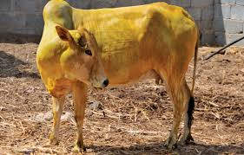
Yellow cow

Slide 13
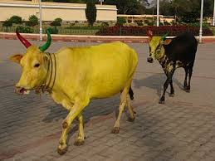
Yellow cow

Slide 14
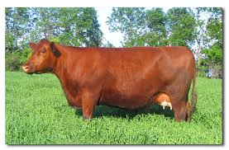
Red cow

Slide 15
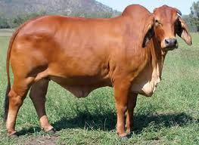
Red cow

Slide 16
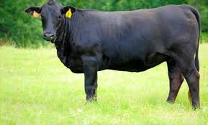
Black cow

Slide 17
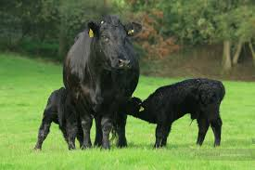
Black cow

Slide 18
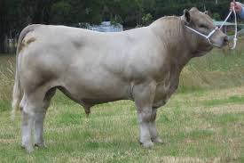
White&grey

Slide 19
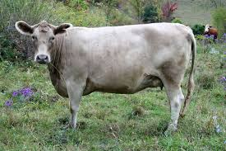
White&grey

Slide 20
h-Head marks .
1-Star 2-Muzzle..
i-Marks on tail

Slide 21
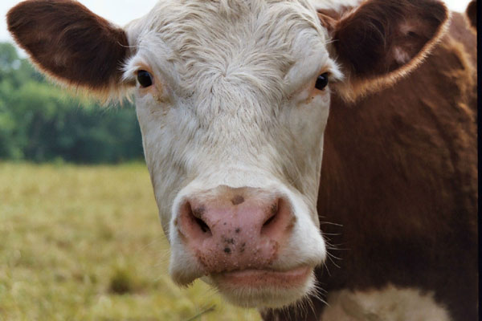
Meaty muzzle

Slide 22
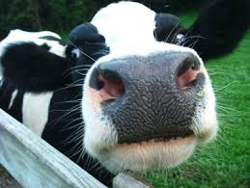
muzzle

Slide 23
3-Horns :- There are four type of horns in cattle
a- Stretched horns b-Closed horns c-Round horns d-Ghazzel horns .

Slide 24
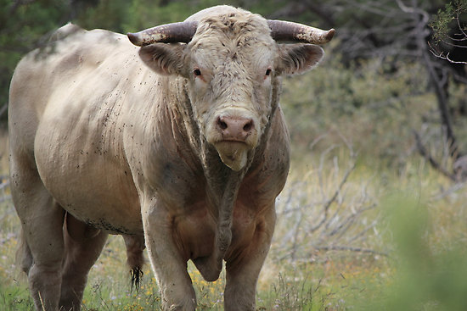
Stretched horns/charola breed

Slide 25
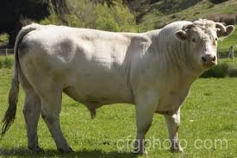
Stretched horns/charola breed

Slide 26
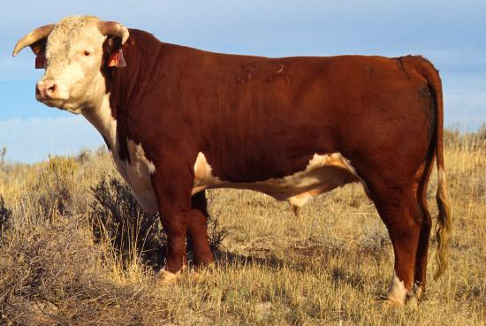
Closed horns/Hereford breed

Slide 27
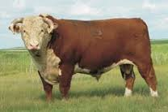
Closed horns/Hereford breed

Slide 28
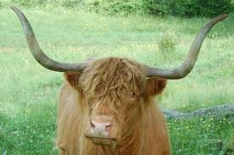
Round horns/Jery breed

Slide 29
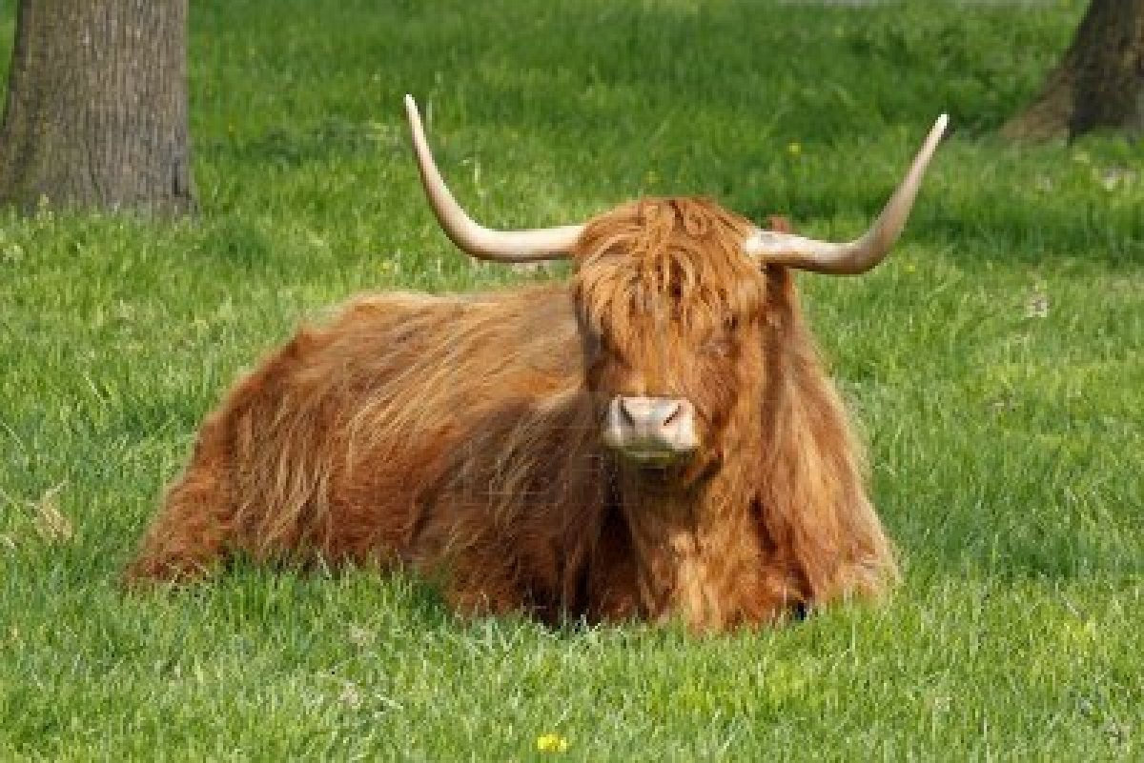
Round horns/Jersy breed

Slide 30
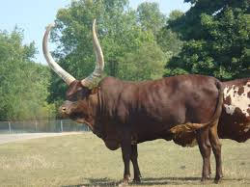
Ghazzel horns/watusi breed

Slide 31
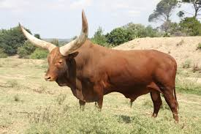
Ghazzel horns/watusi breed

Slide 32
i-Marks on tail

Slide 33
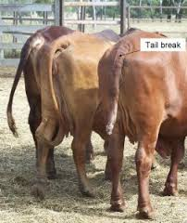

Slide 34
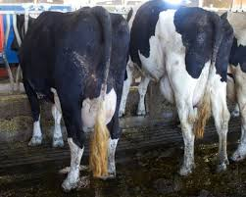

Slide 35
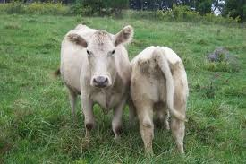

Slide 36
Identification of sheep
1-collective identification.
2-Individual identification:- can doing by
a-Tattooing on the Ear or the upper gum .
b-Ear tagging.
c-Numbering of sheep :- can do by different methods are :- spray body by color, Ear notching & panel marking

